Slide 1
Build Native Cross-Platform apps with .NET MAUI & Blazor Hybrid Workshop
Part 5 – Theming the App

Slide 2
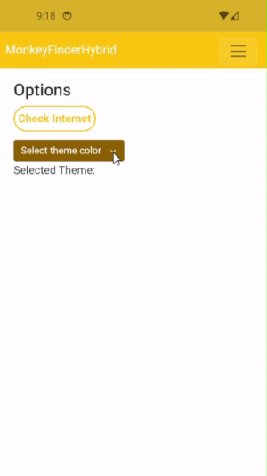
Theming the App
Blazor through HTML & CSS
All built-in capabilities work
.NET MAUI pages through XAML
Implement your own branding
Support light and dark theme
Notes:
To theme our app we can use HTML & CSS for Blazor. Everything that works there, also works for Blazor Hybrid, including any light and dark theme support.
The .NET MAUI pages, if you use those, will need their own styling through XAML. To make for a great user-experience, make sure that those are in line as much as possible.
With this, you can implement your own branding and support light and dark theme throughout your application.

Slide 3

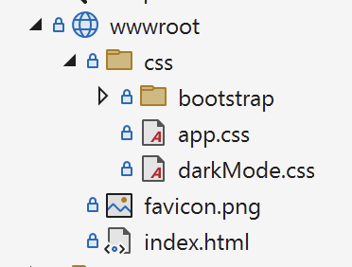
Separate Stylesheets to Define Themes
<!-- index.html -->
<link id="light-mode" rel="stylesheet" href="css/app.css" />
<link id="dark-mode" rel="stylesheet" href="css/darkMode.css" disabled />
Notes:
One of the ways to implement light and dark theme is through separated stylesheets. This might not be the most efficient for light/dark theme, but by doing it like this we can see a couple of concepts.
Like this we will learn about JavaScript Interop and while we use it here for light and dark theme, this will also help you implement your own custom branding like this.

Slide 4
CSS Isolation
Scope CSS styling to a single component
MyComponent.razor
MyComponent.razor.css
Useful for reusable components
Notes:
With CSS isoliation you can scope the CSS styling to a single component.
You can implement this by simply adding a file with the name of your component, including .razor, but add .css behind it.
This is particularly useful for reusable components so you are assured that no other styling with the same name will influence the styling of your component.

Slide 5
JavaScript Interoperability
<!-- index.html -->
<script>
function methodName(argument1)
{
// ... Implementation here
}
</script>
Notes:
With Blazor Hybrid you can still use JavaScript if you want or whenever needed. You can define JavaScript as you normally would, like in this case in the index.html

Slide 6
JavaScript Interoperability
// OptionsPage.razor
@page "/options"
@inject IJSRuntime JS
@code {
private async Task ChangeTheme()
{
await JS.InvokeVoidAsync("methodName", "argument1");
}
}
Notes:
Then from a Razor file you can use the IJSRuntime object to make the connection to the JavaScript world. There are a couple of methods you can use to invoke JavaScript. If you don’t expect any return value, you can use InvokeVoidAsync. As parameters, specify the method name and then a list of argument values that are expected by the JavaScript method.

Slide 7
.NET MAUI Theming
Query OS theme setting in .NET MAUI using Application.Current.RequestedTheme;
Override the OS setting for your app with Application.Current.UserAppTheme = AppTheme.Dark;

Slide 8
.NET MAUI AppThemeBinding
The AppThemeBinding markup extension automatically adjusts the value based on the detected theme of the device
<!-- MonkeyRatingPage.xaml -->
<ContentPage
BackgroundColor=”{AppThemeBinding Dark=Black, Light=White}" />
</ContentPage>
Notes:
With the AppThemeBinding in .NET MAUI you can specify values that will automatically be used if the system setting is set to light or dark theme.

Slide 9
Styling Isolated Components
FluentUI Components handle their theme separately, which you can set using <FluentDesignTheme />
Use the .NET MAUI Community Toolkit for other UI elements such as the status bar

Slide 10
Part 5 – Theming the App
https://aka.ms/blazor-hybrid-workshop

